Slide 1
Application of Algorithm in Game Design
Procedural Maze Algorithm Based on Pac-Man Game
Hongfan Liu, 784161169@qq.com, +86 15618122060
Kwan Man Cheng, chengkwanman12138@gmail.com, +86 18301601708
Xinyu Dou, xinyudou147@gmail.com, +1 8147532239

Slide 2
01
Background
02
The Data Structure we used
CONTENTS
03
The Main Game Loop
04
The Improved Maze Generation Algorithm

Slide 3
01
Background

Slide 4
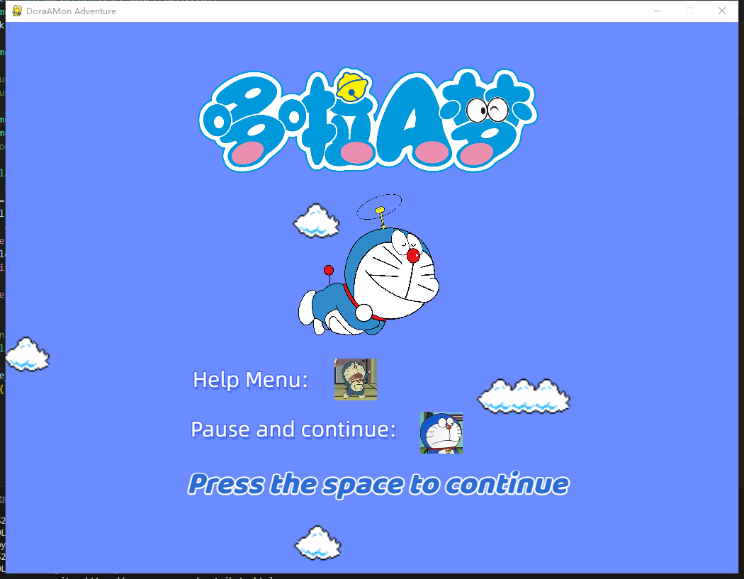
Background
Background
We wrote a pac-man-like game and applied the maze generate algorithms we learned on it to make the game be more fun.

Slide 5

The Reason We Choose The Topic
Tranditional Pac-Man
The tranditional Pac-Man used the maze they already drawn, every time player restart the game, they will see the same maze
Our Game
After we implemented an improved algorithm on the Pac-Man-like game, every time player restarts the game, they will see a different maze but the difficulty be similar.

Slide 6

How we work together?
We use the data structure we learned and used in homework, modified it to fit the requirements in the game, since all of us have done the homework, we could write our own part at the same time and didn’t need to worry about the conflict of the codes.

Slide 7
02
The Data Structure We used

Slide 8
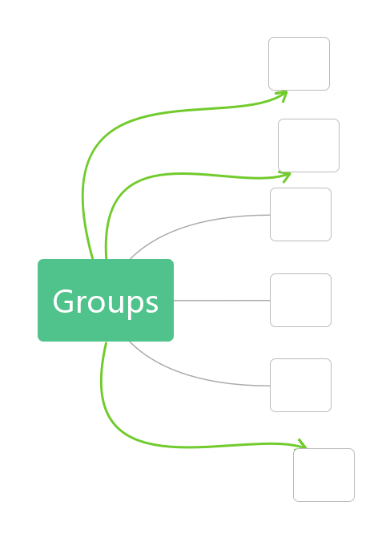







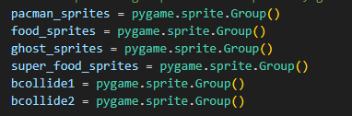



We have several spirites and spirite groups
Groups we initialized:

Slide 9

How powerful the ghosts are?
Level 1 --
Honekawa Suneo
Okaasan
Level 2 --
Sensei
Level 3 --
Gōda Takeshi

Slide 10
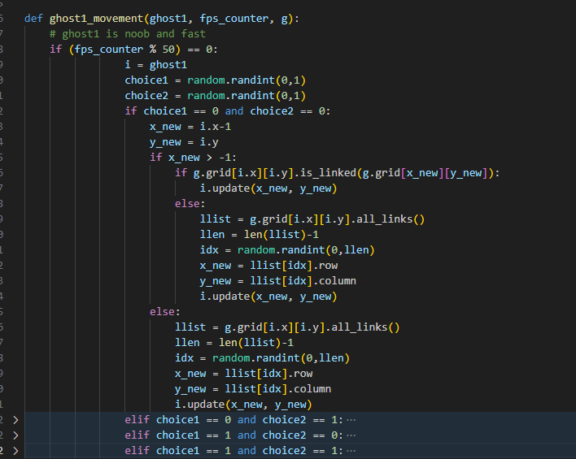
The Ghost Movement 1 - Randomly walking

Slide 11
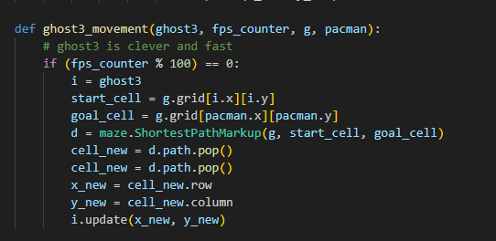
The Ghost Movement 2 - Chasing the player

Slide 12
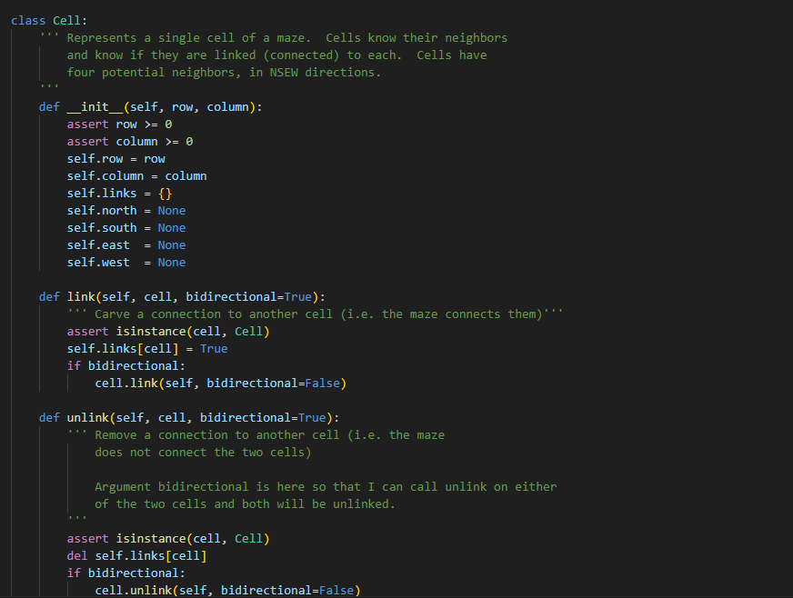
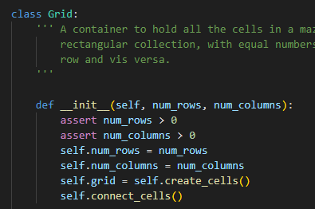
How we generate the maze?
Cell --
Grid --

Slide 13
03
The Main Game Loop

Slide 14
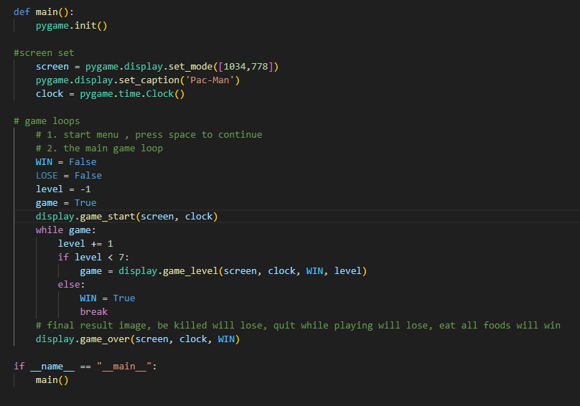
The Main Game Loop
The procedures
1.The Start Menu
2.The Main Game
3.Game Over

Slide 15
The Start Menu

Slide 16
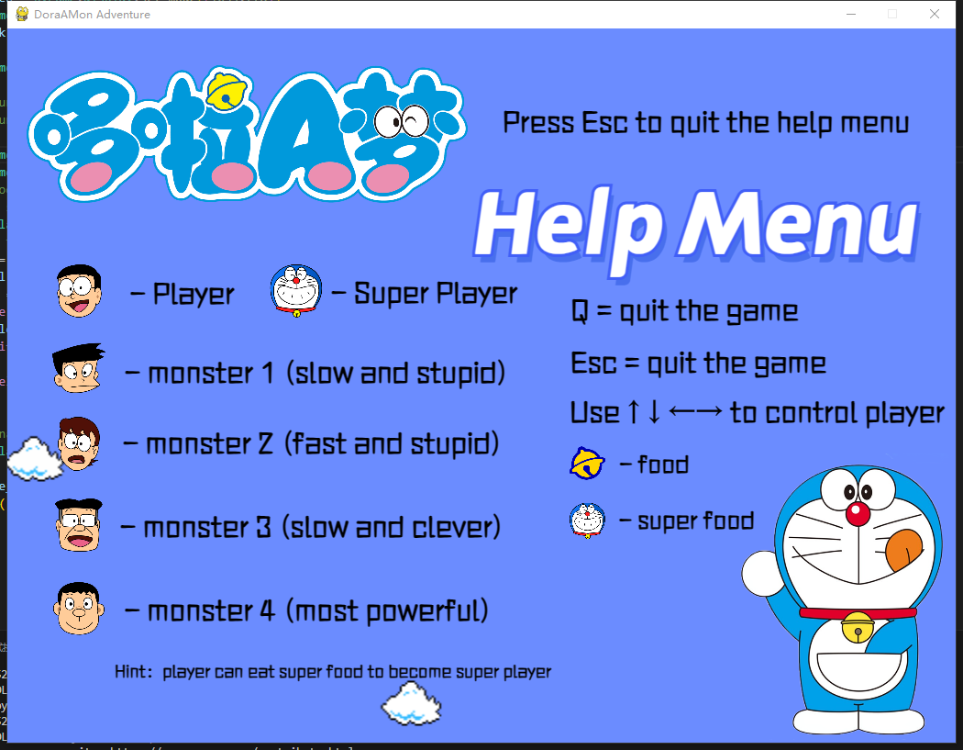
How to play the game

Slide 17
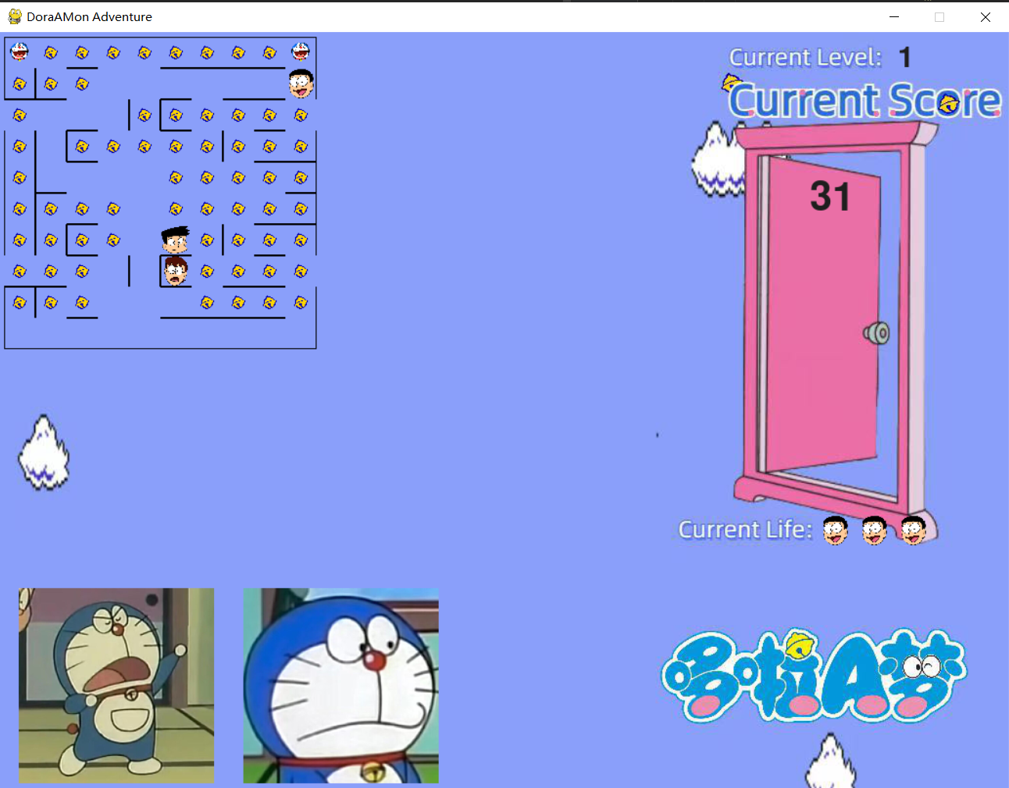
Level 1

Slide 18
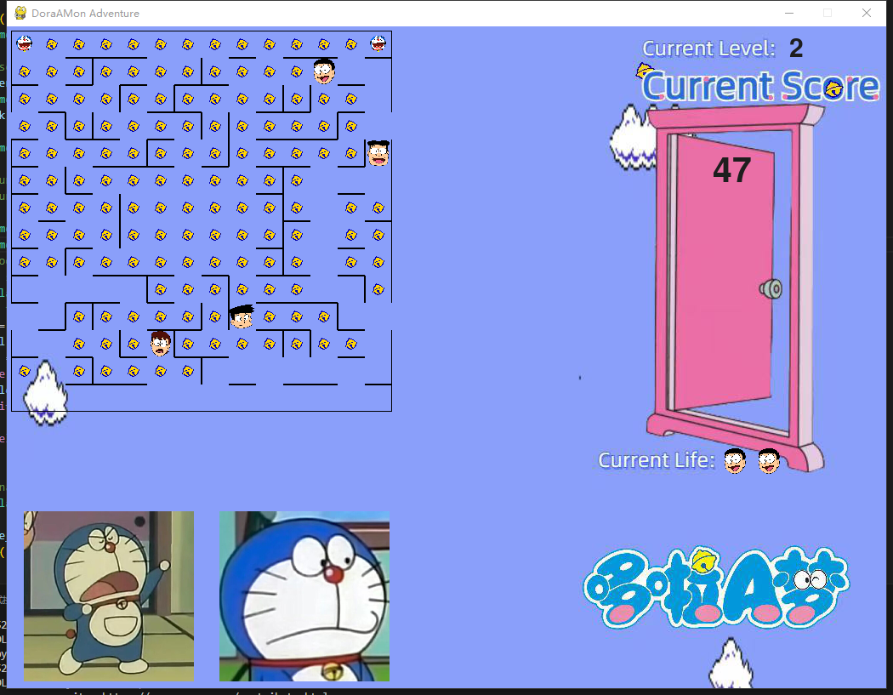
Level 2

Slide 19
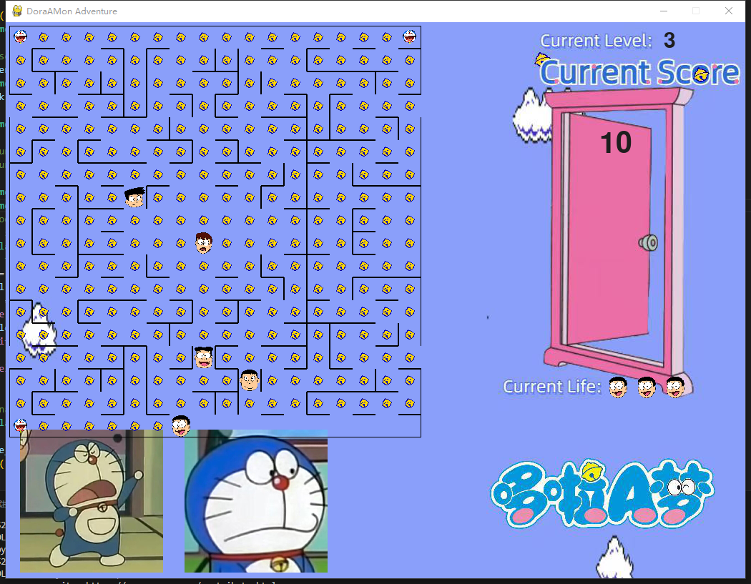
Level 3

Slide 20
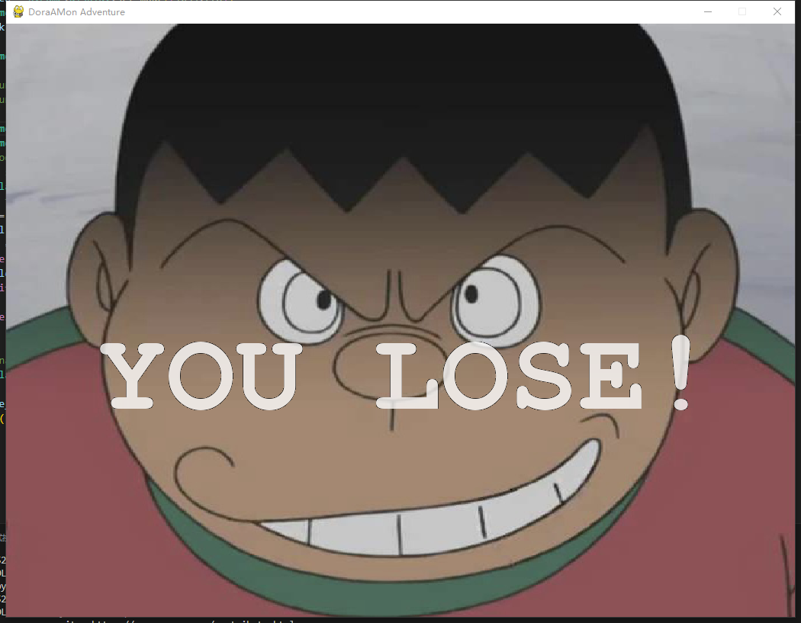
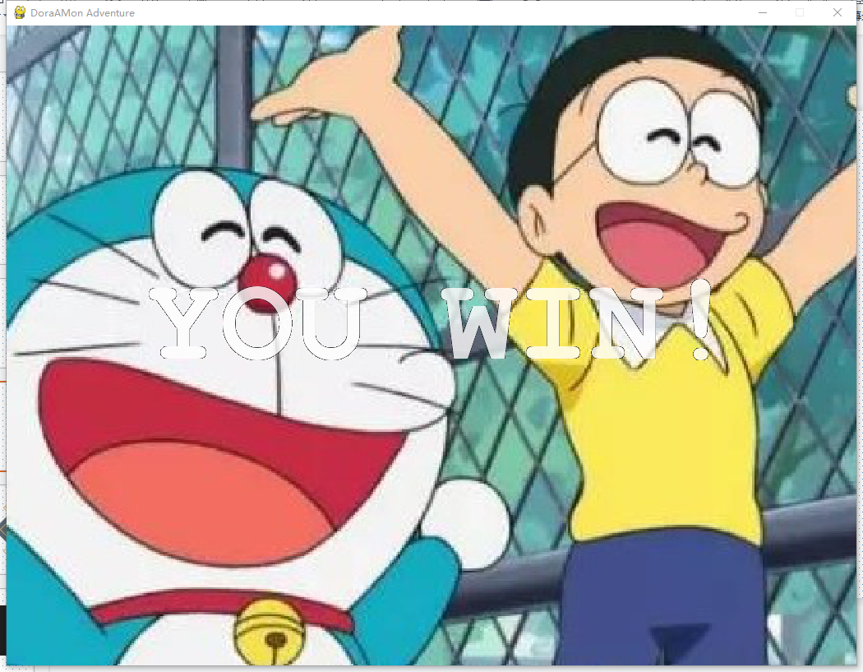
Game Over

Slide 21
04
The Improved Maze-Generation Algorithm

Slide 22
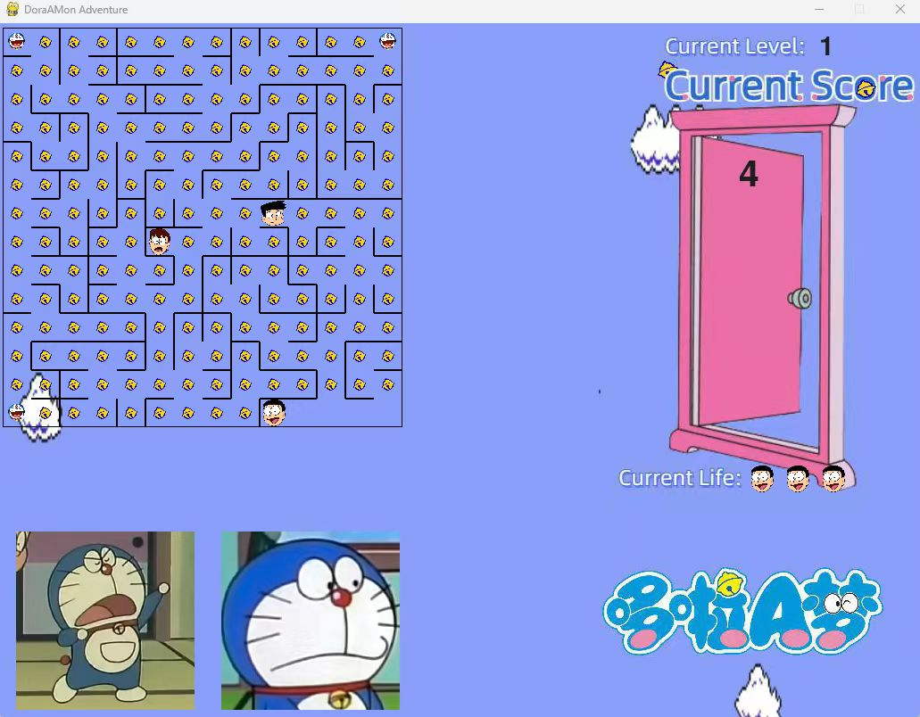
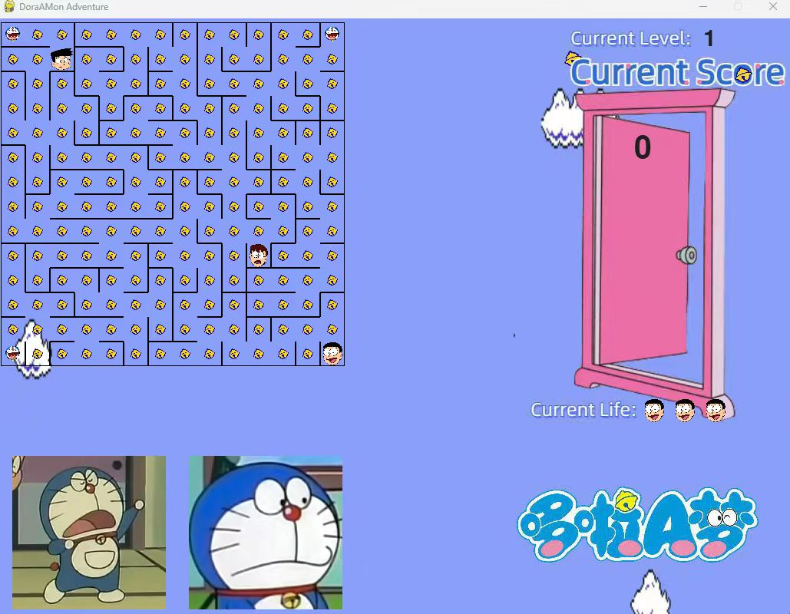
The Improved Maze Generation: Algorithm 1

Slide 23
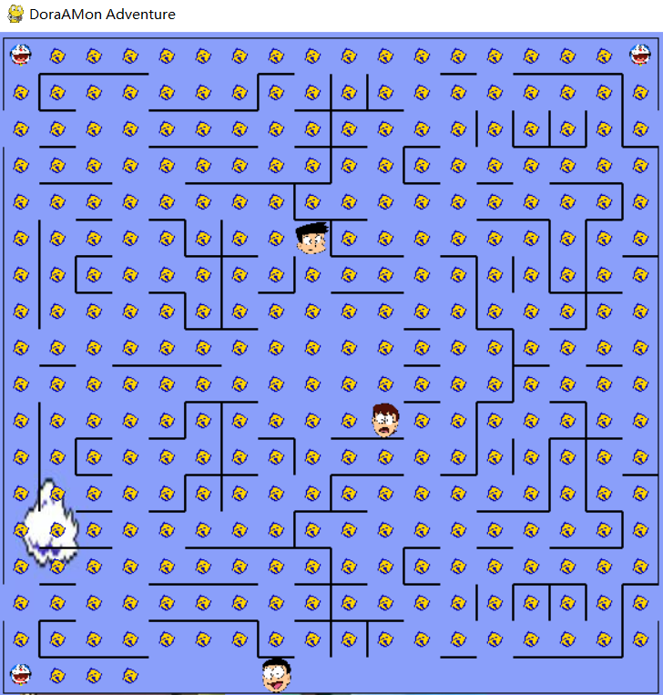
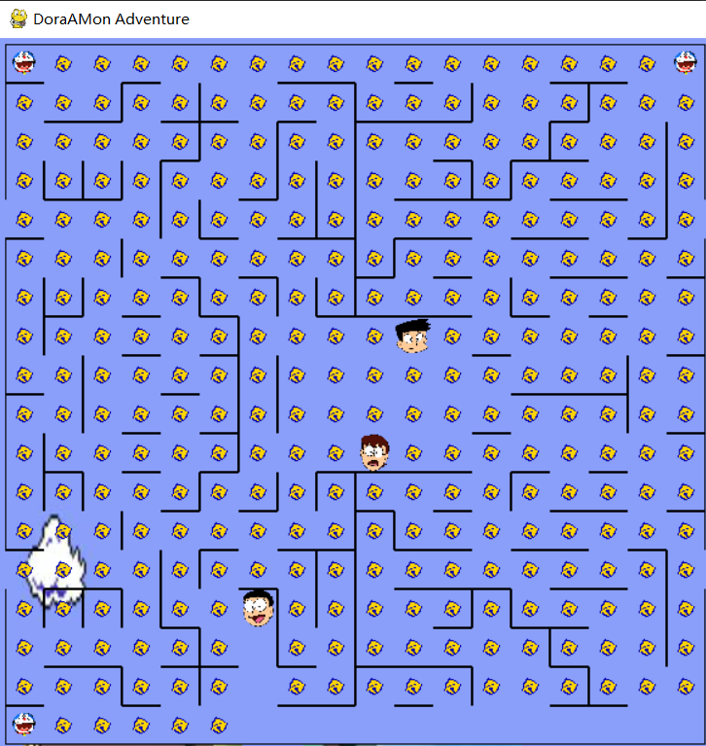
The Improved Maze Generation: Algorithm 2

Slide 24
Evaluation Function Based On A* algorithm
Heuristic Function: distance to the nearest food + MST of all food
Admissible & Consistent
Random coordinate generator: Reduce time complexity.
Measure the approximate minimum steps for Pacman to eat all the food.
Evaluation Function Based On Ai Simulating (Still in progress)
Combination of Mini-Max & Expectimax Tree Search
Simulate real-life conditions.
Iterate many times and measure the winning ratio of the Ai Pacman agent.

Slide 25
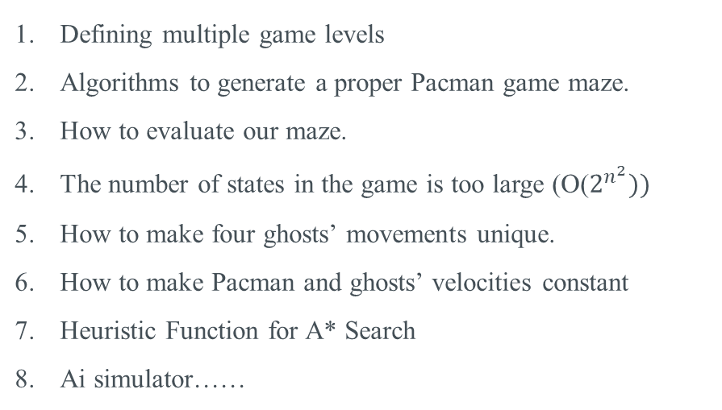
The Challenges We Met
Challenges
Defining multiple game levels
Algorithms to generate a proper Pacman game maze.
How to evaluate our maze.
The number of states in the game is too large (O($2^{n^{2}}))$
How to make four ghosts’ movements unique.
How to make Pacman and ghosts’ velocities constant
Heuristic Function for A* Search
Ai simulator……

Slide 26
That’s ALL
Thanks!

